Slide 1
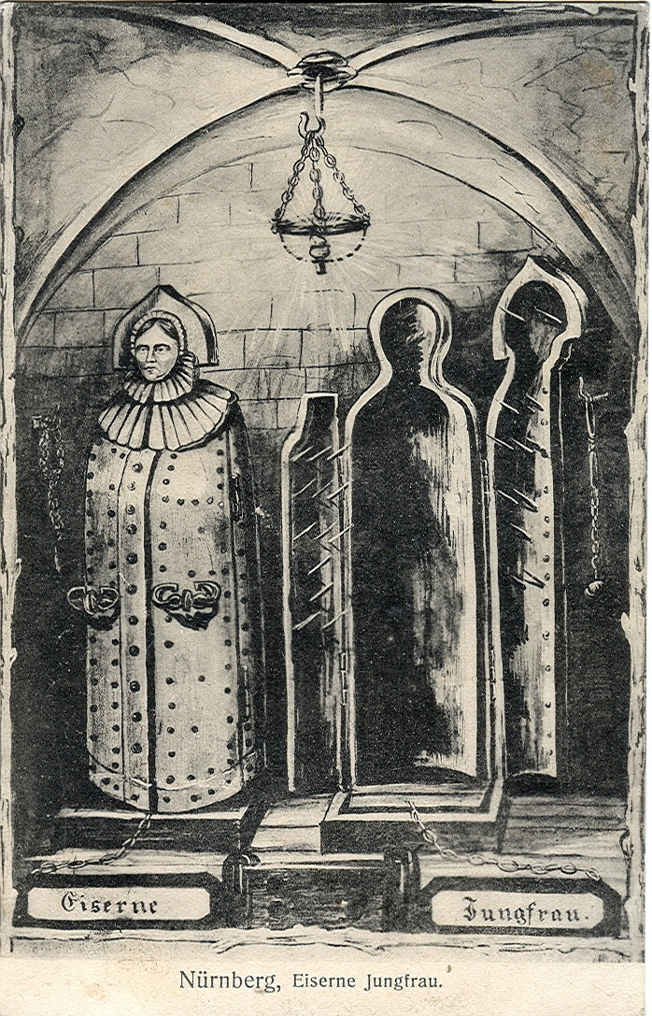
THE IRON MAIDEN
Bram Stoker

