Slide 1
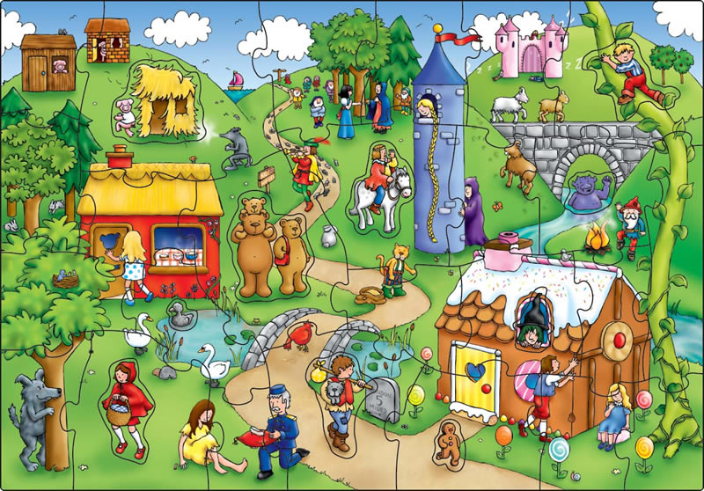
First Grade
Unit 2
Environment: Literary and Ludic
Communicative activity: Literary expression.
Social practice of the language:
Read classic tales.
Classic tales
Read the descriptions and guess the
classic tales.

Slide 2
Classic tales
NAME THE CLASSIC TALE
Read the description and guess the classic tale.
Three little pigs
This tale is about a hungry wolf who wants to catch three pigs.

Slide 3
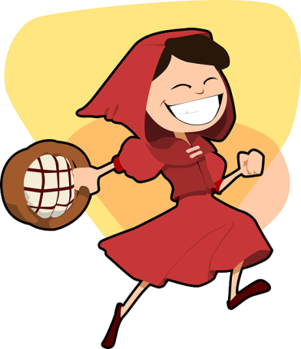
Classic tales
NAME THE CLASSIC TALE
Read the description and guess the classic tale.
Little red riding hood
This tale is about a girl who visits her grandma but she meets a bad wolf in the forest.

Slide 4
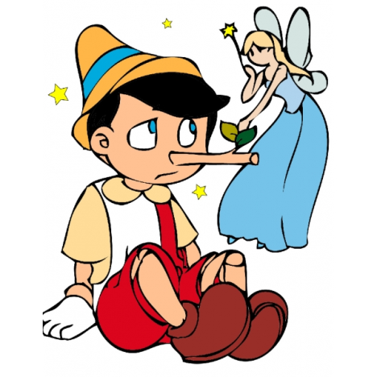
Classic tales
NAME THE CLASSIC TALE
Read the description and guess the classic tale.
Pinocchio
This tale is about a wooden boy who lives with an old carpenter and wants to be a real boy.

Slide 5
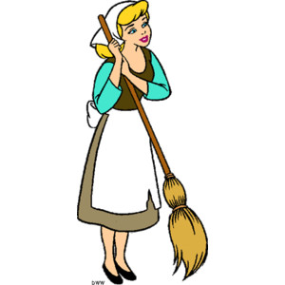
Classic tales
NAME THE CLASSIC TALE
Read the description and guess the classic tale.
Cinderella
This tale is about a servant girl who lives with her evil stepmother and stepsisters. She goes to a ball and the prince falls in love with her.

Slide 6
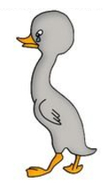
Classic tales
NAME THE CLASSIC TALE
Read the description and guess the classic tale.
The ugly duckling
This tale is about a little bird born in a barnyard who suffers abuse from the other ducks around him until, he matures into a beautiful swan.

Slide 7
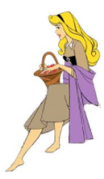
Classic tales
NAME THE CLASSIC TALE
Read the description and guess the classic tale.
Sleeping beauty
This tale is about a beautiful princess who sleeps for many years when a prince appears and wakes her up.

Slide 8
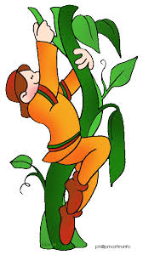
Classic tales
NAME THE CLASSIC TALE
Read the description and guess the classic tale.
Jack and the beanstalk
This tale is about a boy who goes up a beanstalk to rescue a little girl who has been transformed into a harp.

Slide 9
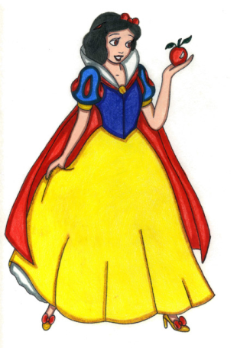
Classic tales
NAME THE CLASSIC TALE
Read the description and guess the classic tale.
Snow white and the 7 dwarfs
This tale is about girl who lives with seven dwarves. One day she eats a poisoned apple and falls sleep and wakes up with the kiss of a real love.

Slide 10
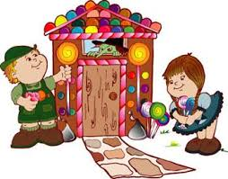
Classic tales
NAME THE CLASSIC TALE
Read the description and guess the classic tale.
Hansel and Gretel
This tale is about a brother and sister who walk in the forest and find a house of candy where an evil witch lives.

