Slide 1
SECOND GRADE
Clothes vocabulary
UNIT 1 PART 1

Slide 2
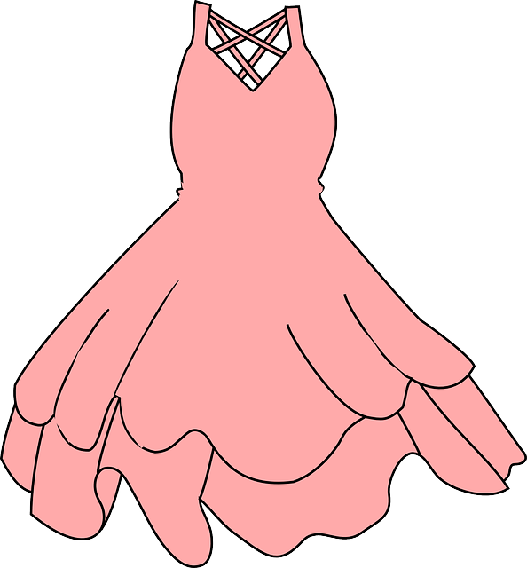
skirt
dress
GREAT!
tights
glasses
vest
suit
coat

Slide 3
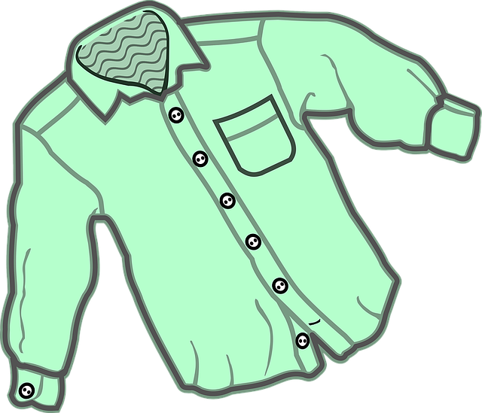
socks
trousers
GREAT!
flip flops
boots
belt
T-shirt
shirt

Slide 4
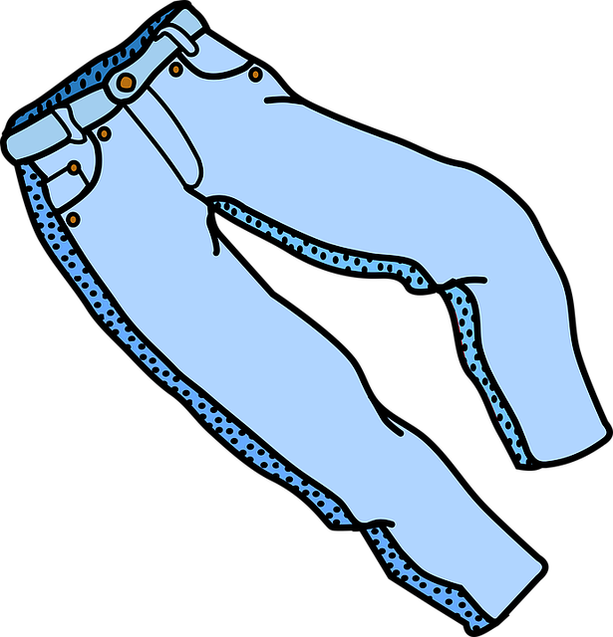
pants
jeans
GREAT!
uniform
leggins
jumper
suit
overalls

Slide 5
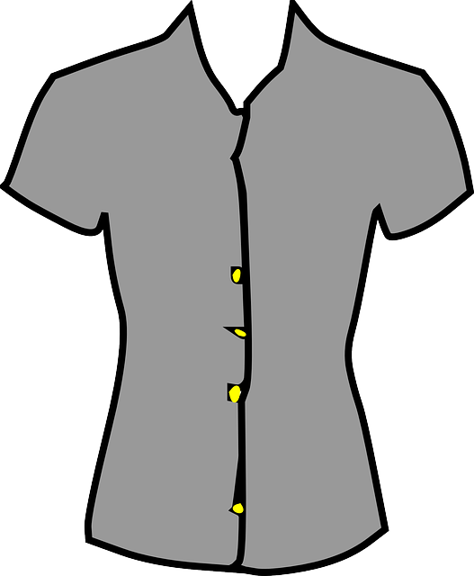
skirt
vest
GREAT!
hat
blouse
shirt
scarf
jersey

Slide 6
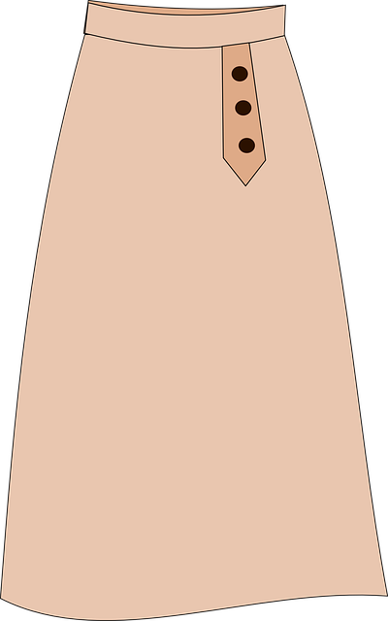
pajamas
skirt
GREAT!
shirt
gown
coat
overcoat
dress

Slide 7
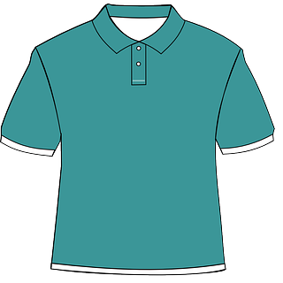
T-shirt
blouse
GREAT!
shirt
turtleneck
sport shirt
Polo shirt
down vest

Slide 8
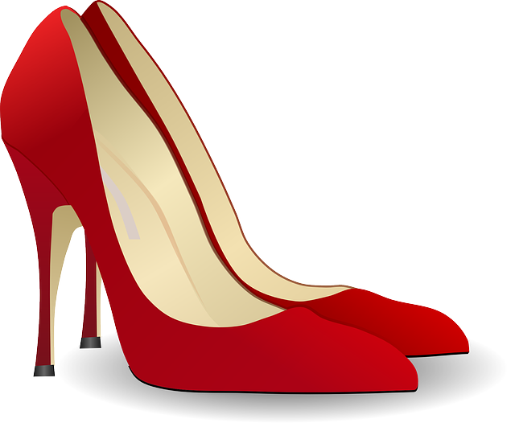
sneakers
boots
GREAT!
flip flops
sandals
high heels
socks
raincoat

Slide 9
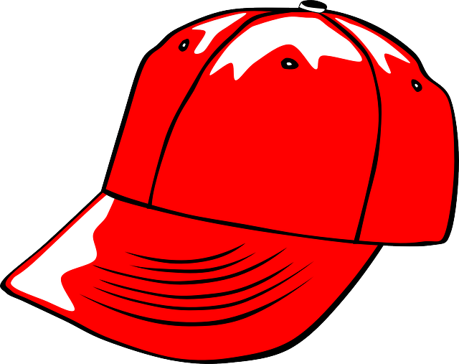
belt
sweatband
GREAT!
tie
helmet
cap
hat
bra

Slide 10
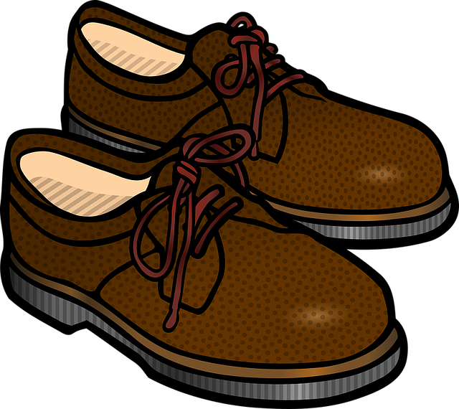
boots
sandals
GREAT!
rain boots
moccasins
loafters
sneakers
shoes

Slide 11
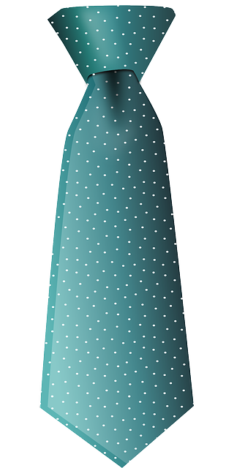
vest
tie
GREAT!
belt
coat
jumper
hat
tuxedo

Slide 12
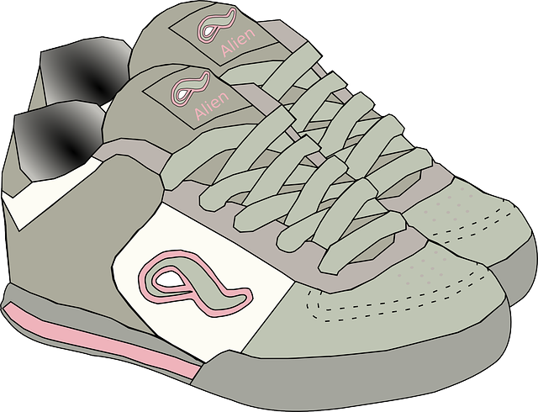
flip-flops
sandals
GREAT!
sneakers
shoes
boots
high heels
work boots

Slide 13
shoes
mittens
GREAT!
slippers
tennis shoes
boots
flip-flops
glasses

Slide 14
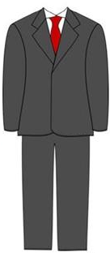
jacket
pants
GREAT!
slacks
uniform
gown
suit
tunic

Slide 15
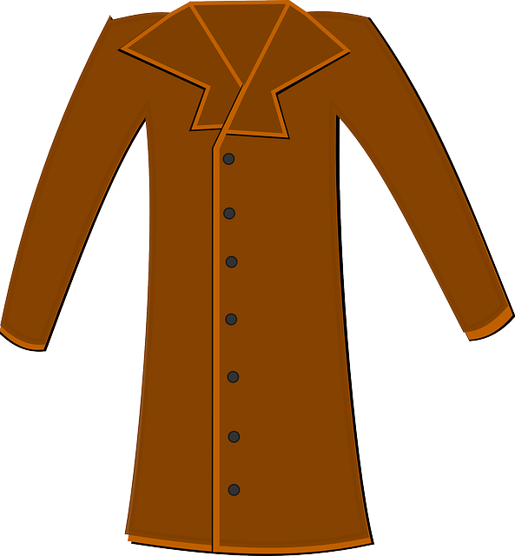
jacket
dress
GREAT!
belt
vest
tie
uniform
coat

Slide 16
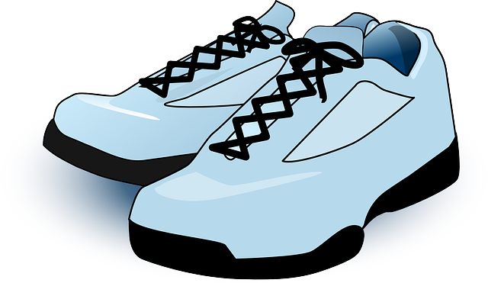
tennis shoes
boots
GREAT!
hiking boots
sneakers
loafters
high-tops
high heels

Slide 17
flip flops
gloves
GREAT!
mittens
slippers
boots
trousers
jeans

Slide 18
raincoat
coat
GREAT!
jacket
fur coat
blazer
jumper
scarf

Slide 19
jeans
pants
GREAT!
trainers
trousers
slippers
scarf
Bermuda shorts

Slide 20
hat
vest
GREAT!
scarf
coat
belt
tie
skirt

Slide 21
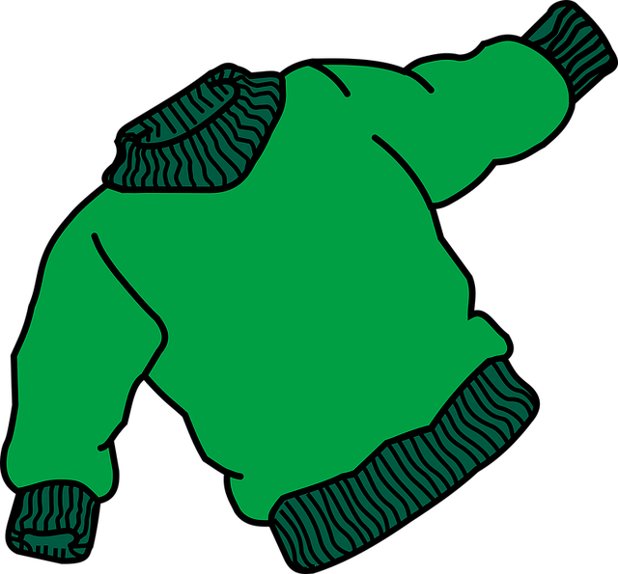
sweater
jacket
GREAT!
cap
fur coat
turtleneck
suit
leggins

Slide 22
parka
jacket
GREAT!
vest
windbreaker
blazer
sweater
coat

Slide 23
overalls
coat
GREAT!
vest
tie
jacket
parka
sweater

Slide 24
cap
mittens
GREAT!
slippers
gloves
boots
hat
glasses

