Slide 1
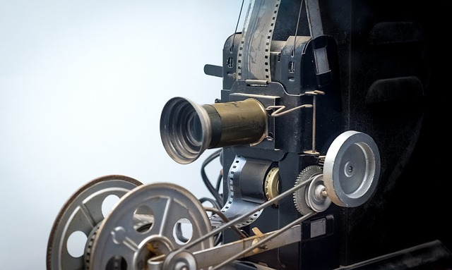
THE SCRIPT
Introduction
Second Grade - Unit 2 Part 2
Environment: Familiar and community
Specific competency: Write dialogues and interventions for a silent short film
Product: Script for the dubbing of a silent short film

Slide 2
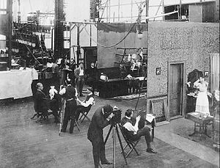
The script - Introduction
When did the films appear?
The history of film began in the 1890s, when motion picture cameras were invented and film production companies started to be established.
Second grade – Unit 2 Part 2

Slide 3
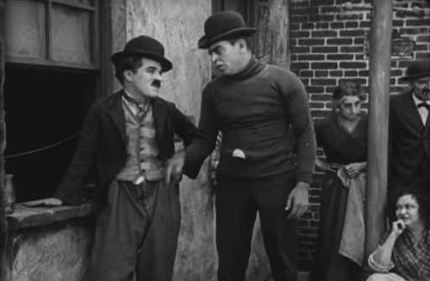
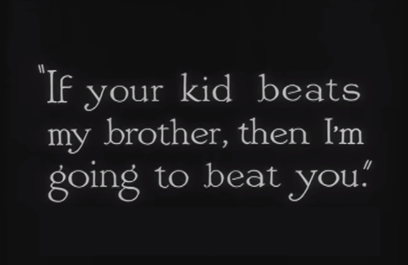
The script - Introduction
Because of the limits of technology, films of the 1890s were under a minute long and until 1927 motion pictures were produced without sound.
Second grade – Unit 2 Part 2

Slide 4
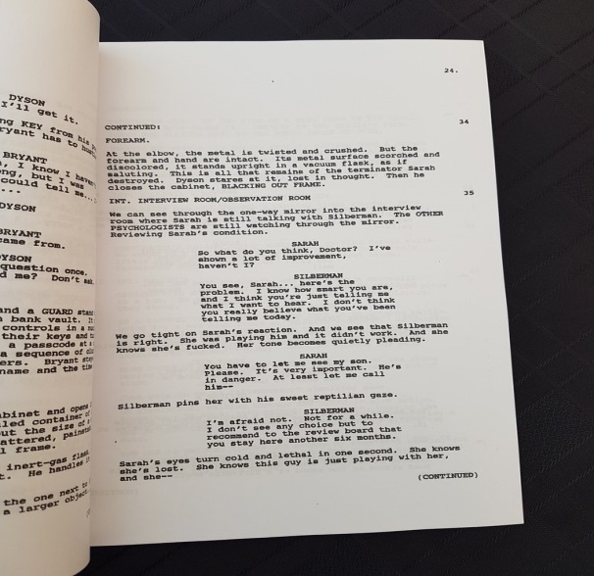
The script - Introduction
What is a script?
A screenplay or script is a written work by screenwriters for a film. It used in preparing for a performance.
In them, the movement, actions, expression and dialogues of the characters are also narrated.
Second grade – Unit 2 Part 2

Slide 5
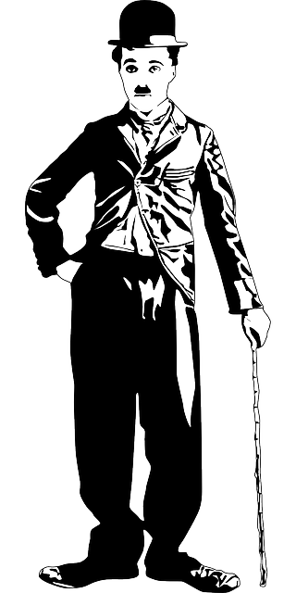
The script - Introduction
What is a silent film?
It’s a film with no spoken dialogue. In silent films for entertainment, the dialogue is transmitted through muted gestures, mime and title cards which contain a written indication of the plot or key dialogue.
Second grade – Unit 2 Part 2

Slide 6
The script - Introduction
Parts of a script
Scene heading
Characters
Action lines
Dialogues
Parenthetical
Second grade – Unit 2 Part 2

