Slide 1
FIRST GRADE
Community services
UNIT 1

Slide 2
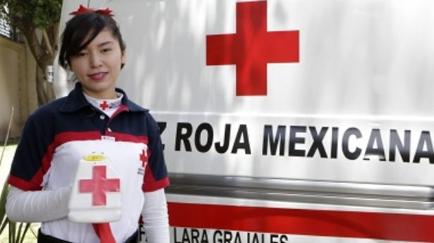
Save endangered species
Donate clothes and money
GREAT!
Raise money for the local red cross
Collect old coins

Slide 3
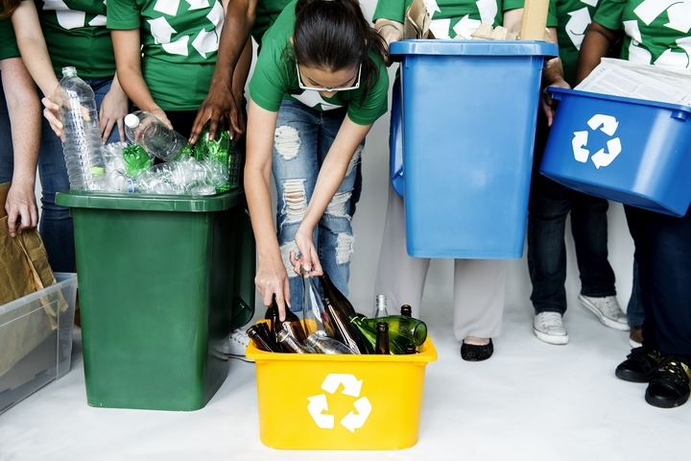
Throw away garbage
Participate in recycling program
GREAT!
Donate old toys
Clean up a
local park

Slide 4
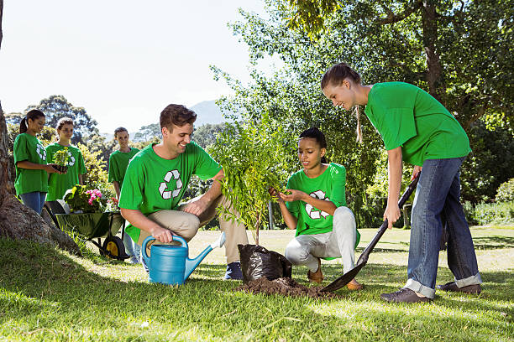
Clean up a
local park
Donate food
GREAT!
Plant trees
Raise money

Slide 5
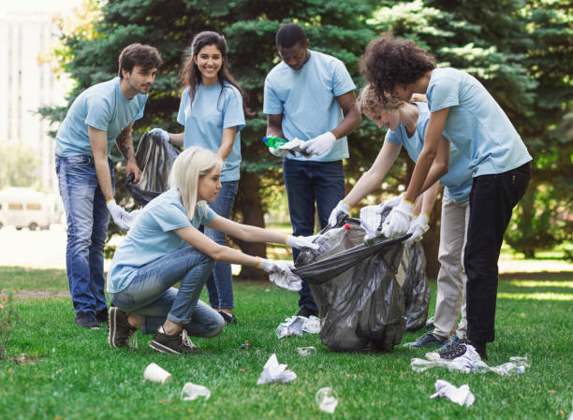
Help elderly people
Throw away garbage
GREAT!
Donate food
Clean up a
local park

Slide 6
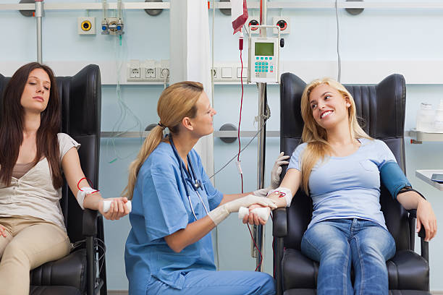
Donate blood
Donate food
GREAT!
Donate toys
Donate paint

Slide 7
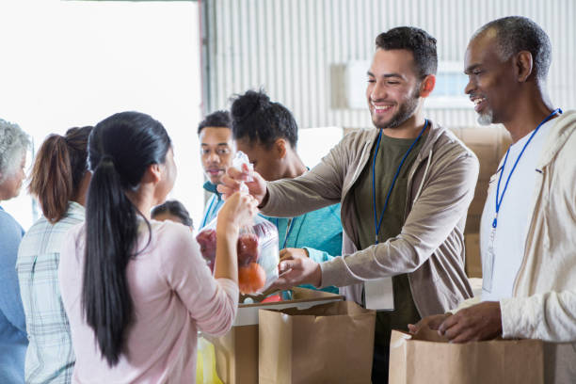
Donate aluminium
Donate food
GREAT!
Donate clothes
Donate boxes

Slide 8
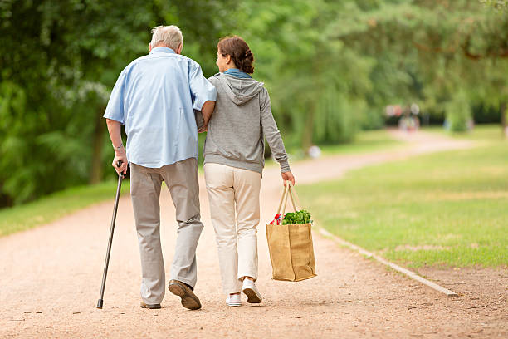
Clean up a local park
Help elderly people
GREAT!
Organize wheelchair games
Feed elderly people

Slide 9
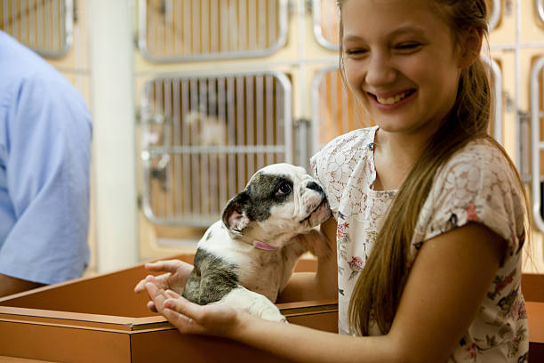
Adopt abandoned pets
Wash your dog
GREAT!
Build a shelter
Feed elderly people

