Slide 1
Parts of the speech
NOUNS
A noun is a word or word group that is used to name
a person, place, thing or an idea.
Person | Place | Thing | Idea
John | Park | Pencil | Music

Slide 2
Parts of the speech
VERBS
A verb “is what you do!” – it shows an action.
Write Escribir | Drive Conducir | Love Amar

Slide 3
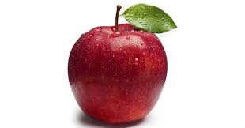
Parts of the speech
Look at the picture and the word given.
What’s is the abbreviation and part of speech?
apple
n. - noun

Slide 4
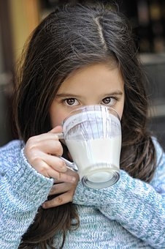
Parts of the speech
Look at the picture and the word given.
What’s is the abbreviation and part of speech?
drink
v. - verb

Slide 5
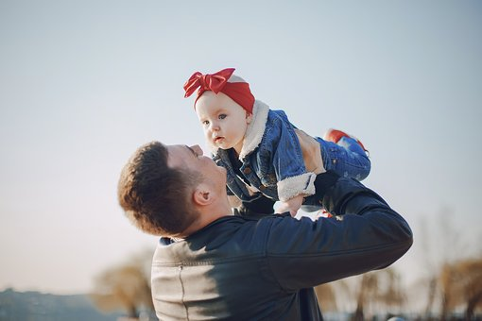
Parts of the speech
Look at the picture and the word given.
What’s is the abbreviation and part of speech?
father
n. - noun

Slide 6
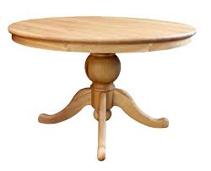
Parts of the speech
Look at the picture and the word given.
What’s is the abbreviation and part of speech?
table
n. - noun

Slide 7
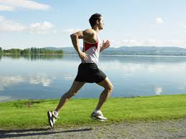
Parts of the speech
Look at the picture and the word given.
What’s is the abbreviation and part of speech?
run
v. - verb

Slide 8
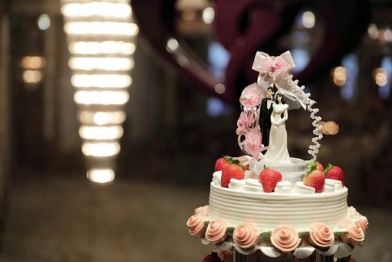
Parts of the speech
Look at the picture and the word given.
What’s is the abbreviation and part of speech?
cake
n. - noun

Slide 9
Parts of the speech
Look at the picture and the word given.
What’s is the abbreviation and part of speech?
flower
n. - noun

Slide 10
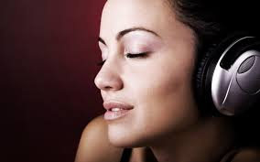
Parts of the speech
Look at the picture and the word given.
What’s is the abbreviation and part of speech?
listen to
v. - verb

Slide 11
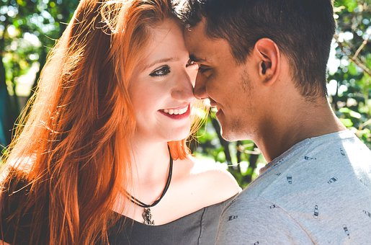
Parts of the speech
Look at the picture and the word given.
What’s is the abbreviation and part of speech?
love
n. noun / v. - verb

