Slide 1
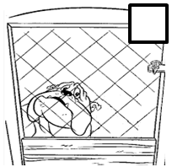
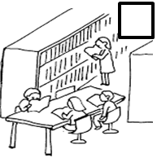
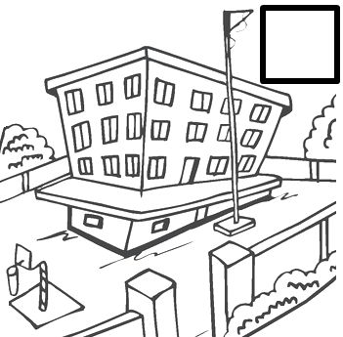
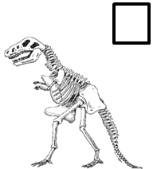
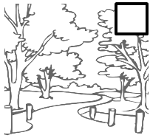
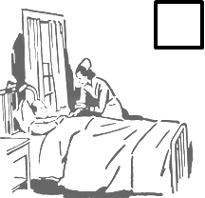
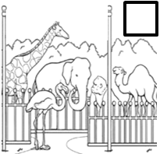
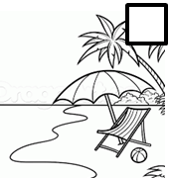
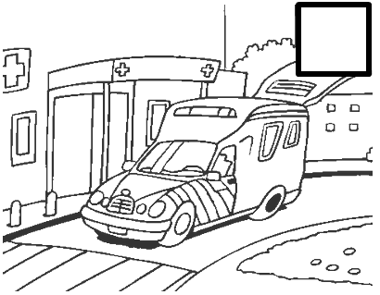
Where to do a community service
Unit 1 P1
1st Grade
Listen and number the pictures in the order you hear them. Then label the places where you can do a community service using the words from the box.
Park – Hospital – School – Library – Zoo Animal shelter – Nursing home – Museum – Beach
For more Free Worksheets, PowerPoint presentations and more visit www.juicyenglish.com now!

