Slide 1
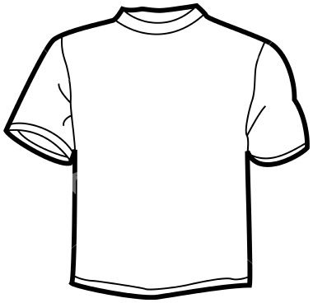
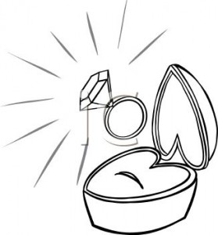
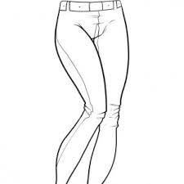
Describing clothes
Unit 1 P1
2nd Grade
Complete the sentences with the following adjectives.
big – expensive – small – nice – skinny - new
1 2 3 4 5 6
The red T-shirt is _______s m a l l _______
The blue T shirt is _____________________
This engagement ring is very _____________________
These hiking boots are _____________________
That turquoise blouse is _____________________
Those blue jeans are _____________________
For more Free Worksheets, PowerPoint presentations and more visit www.juicyenglish.com now!

Slide 2
Describing clothes
Unit 1 P1
2nd Grade
Complete the sentences using the correct form of verb to be (is/are).
Example:
This necklace __i s__ (be) perfect for my dress.
My favorite skirt ______ (be) very old and dusty.
The red dress ______ (be) too big for her.
The black skinny jeans __ (be) really cheap on eBay.
Those glasses ______ (be) too expensive.
For more Free Worksheets, PowerPoint presentations and more visit www.juicyenglish.com now!

Slide 3
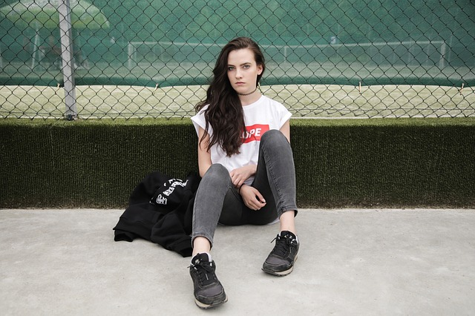
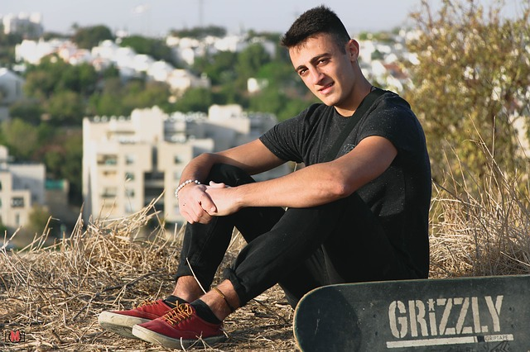
Describing clothes
Unit 1 P1
2nd Grade
Now describe your favorite clothes
Describe your favorite clothes.
_______________________
_______________________
_______________________
_______________________
_______________________
_______________________
For more Free Worksheets, PowerPoint presentations and more visit www.juicyenglish.com now!

