Slide 1
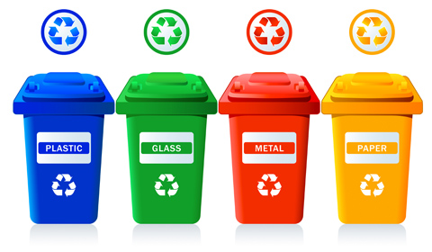
COMMUNITY SERVICE
1-1

Slide 2
RECYCLE
PLASTIC, GLASS, METAL, PAPER, TEXTILES, TIRES
AND ELECTRONICS
1-2

Slide 3
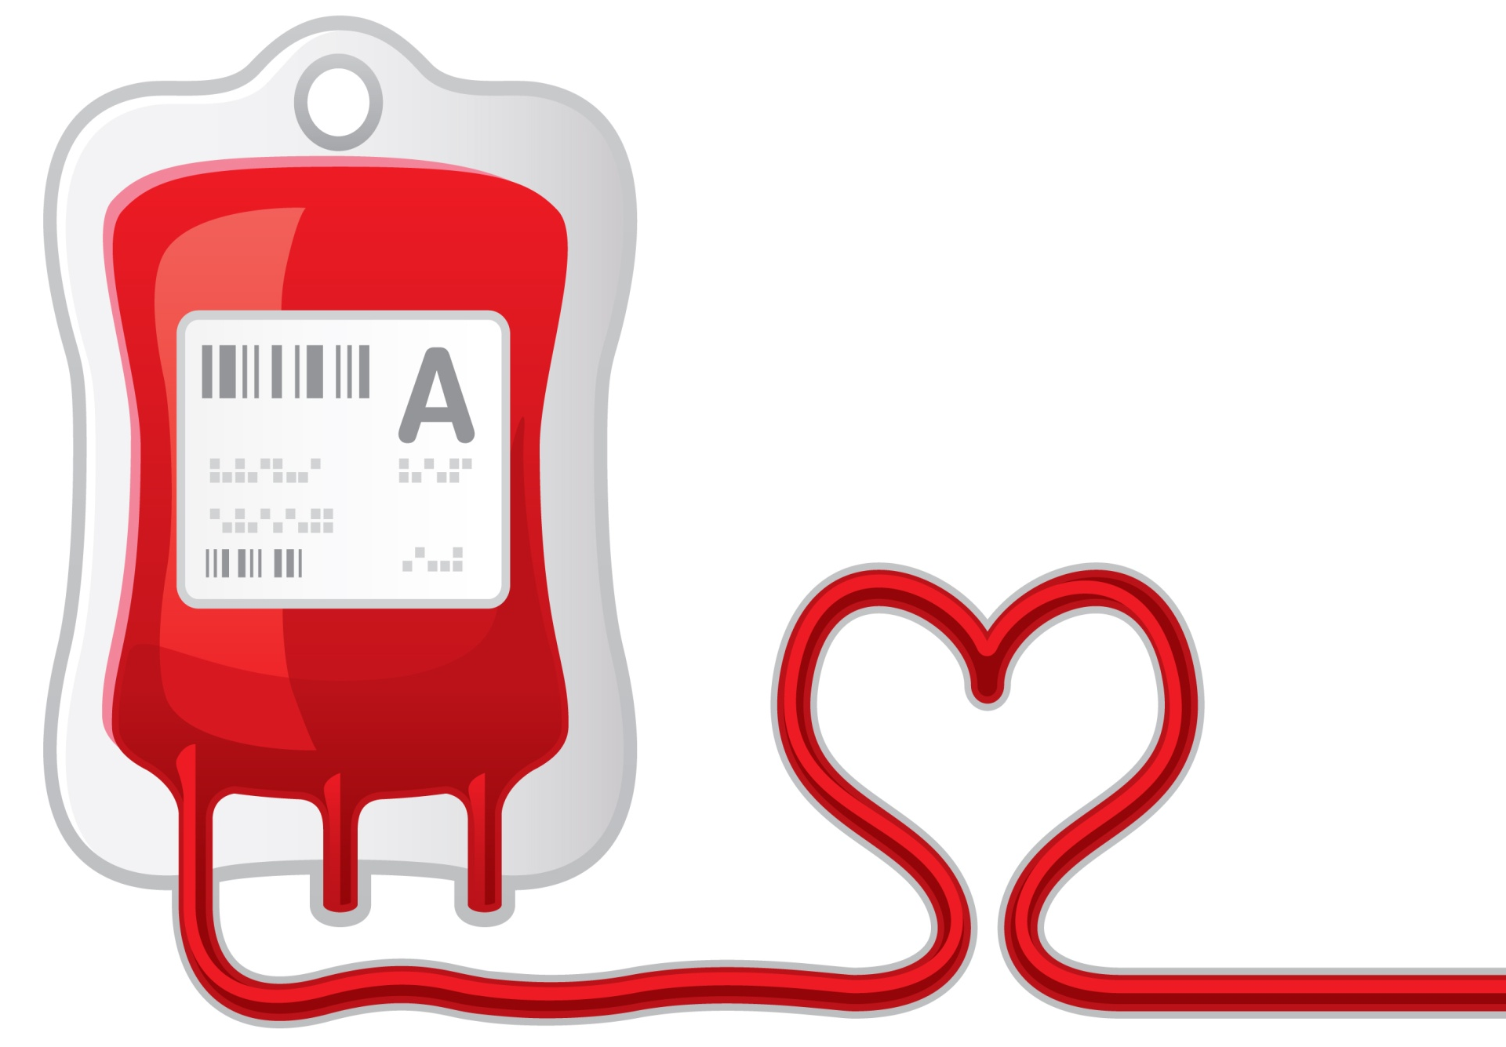
COMMUNITY SERVICE
2-1

Slide 4
DONATE
BLOOD, ORGANS, FOOD, TOYS, MONEY AND CLOTHING
2-2

Slide 5
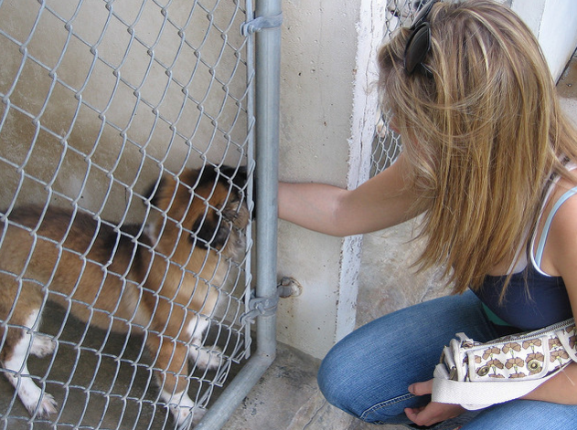
COMMUNITY SERVICE
3-1

Slide 6
ADOPT
A PET, A CHILD, A HIGHWAY,
A PLANT OR A TREE
3-2

Slide 7
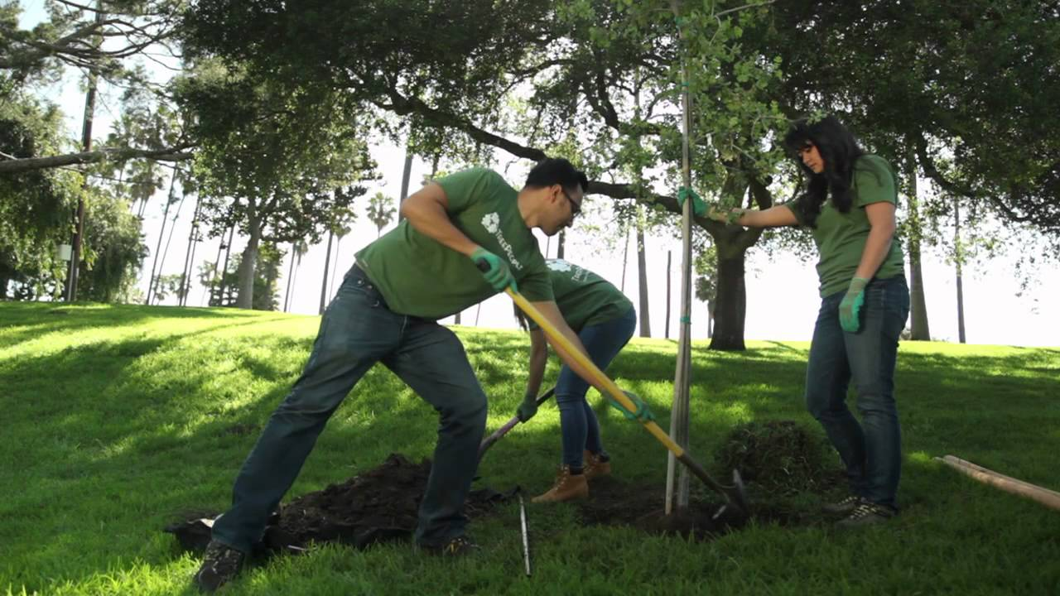
COMMUNITY SERVICE
4-1

Slide 8
PLANT
A TREE
4-2

Slide 9
COMMUNITY SERVICE
5-1

Slide 10
TUTOR
KIDS
5-2

Slide 11
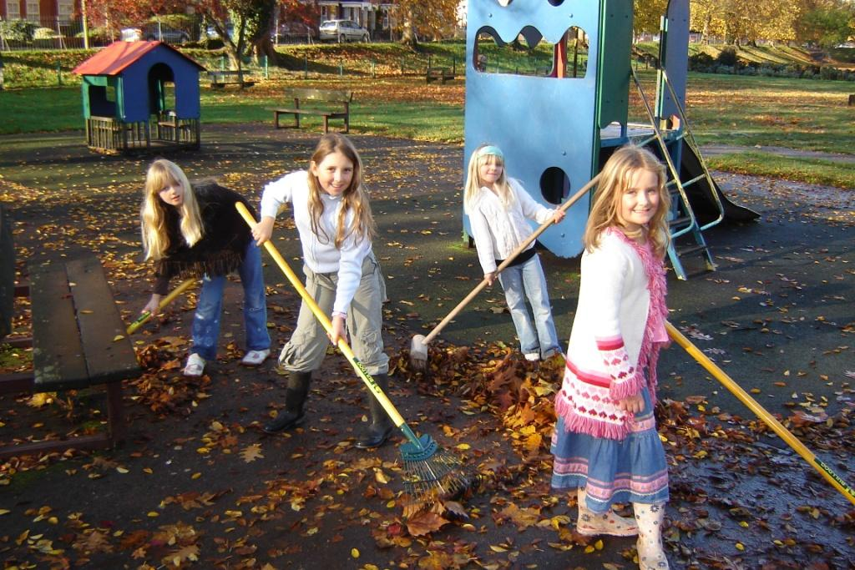
COMMUNITY SERVICE
6-1

Slide 12
CLEAN UP
A PARK OR A BEACH
6-2

Slide 13
COMMUNITY SERVICE
7-1

Slide 14
FEED
A PATIENT OR
PETS FROM THE ANIMAL SHELTER
7-2

