Slide 1
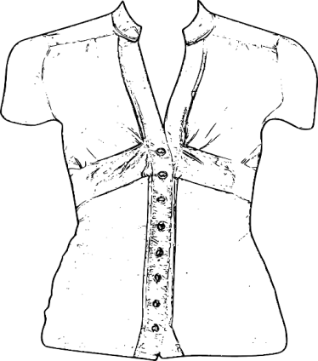
Go shopping
Unit 1 P1
2nd Grade
I. Read the conversation and answer the questions.
1) Megan: 2) Susan: 3) Megan: 4) Susan: 5) Megan: 6) Susan: 7) Megan: (5 min. later) 8) Susan: 9) Megan: | Susan, what do you think of this blouse? I don’t like that color. The red blouse is nicer than the white one. But the red one is more expensive than this one! Really? How much is red one? It’s $22. Mmm, Why don’t you try it on? The changing rooms are over there. Yes, why not? Wow, you look great! I like it. I’ll take it.
Blouses
White $20
Red $22
For more Free Worksheets, PowerPoint presentations and more visit www.juicyenglish.com now!

Slide 2
Go shopping
Unit 1 P1
2nd Grade
What was the conversation about? Is the conversation formal or informal? 3. What is the relationship between the speakers? 4. What was the purpose of the conversation? | □ About stores □ About clothes □ About discounts □ Formal (Follow strict rules and a pre-established channel) □ Informal (It’s flexible and easy to understand, e.g. conversation between friends) □ They are the costumer and seller □ They are friends □ Giving suggestions □ Selling clothes
For more Free Worksheets, PowerPoint presentations and more visit www.juicyenglish.com now!

Slide 3
Go shopping
Unit 1 P1
2nd Grade
II. Discuss these questions with your partner.
What was the last item of clothing you bought?
Where and when did you buy it?
Are you happy with it? Why?
For more Free Worksheets, PowerPoint presentations and more visit www.juicyenglish.com now!

