Slide 1
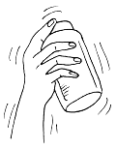
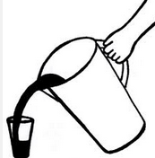
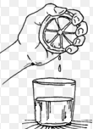
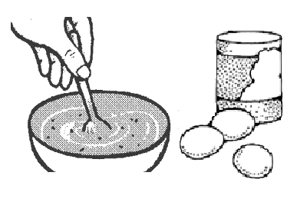
INSTRUCTIONS TO PERFORM EXPERIMENTS
I. Match the instructions with the pictures.
a
1. Fill a glass with water.
2. Mix the sugar, flour and 3 eggs in a bowl.
3. Add drops of food coloring.
4. Squeeze some lemons.
5. Shake the jar vigorously.
b
c
d
e
Third grade – Unit 2 Part 1

Slide 2
INSTRUCTIONS TO PERFORM EXPERIMENTS
II. Complete the instructions with the correct verb.
Squeeze - Mix (x2) – Add -Fill
1. __________________ the ingredients with a spoon. 2. __________________ 2 tablespoons of baking soda. 3. __________________ the bottle with vinegar. 4. __________________ oil, water and salt. 5. __________________ 2 oranges.
Third grade – Unit 2 Part 1

