Slide 1
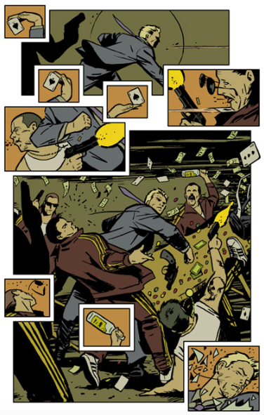
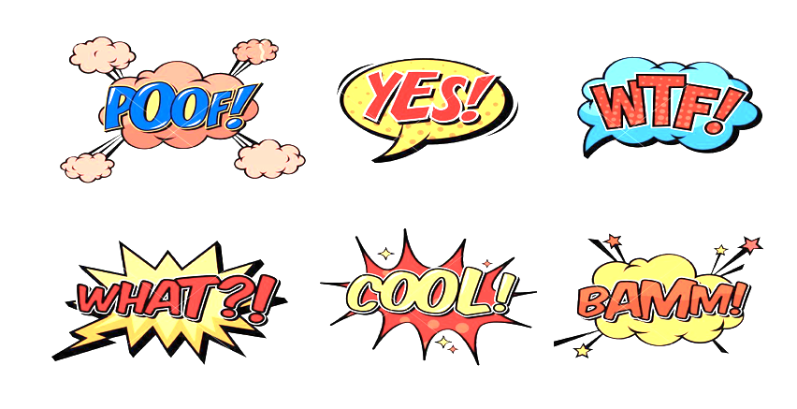
ELEMENTS OF A COMIC STRIP
INSTRUCTIONS
Redraw on your notebook the following comic scenes including the following elements:
Speech balloons
2) Onomatopoeias
Speech Thought Shout Whisper

