Slide 1
First Grade - Unit 3
Environment: Academic and educational
Communicative activity: Interpretation and follow-up of instructions.
Social practice of the language:
Write instructions to use a bilingual dictionary.
Classify types of words
Parts of the speech
and
abbreviations
Intermediate level

Slide 2
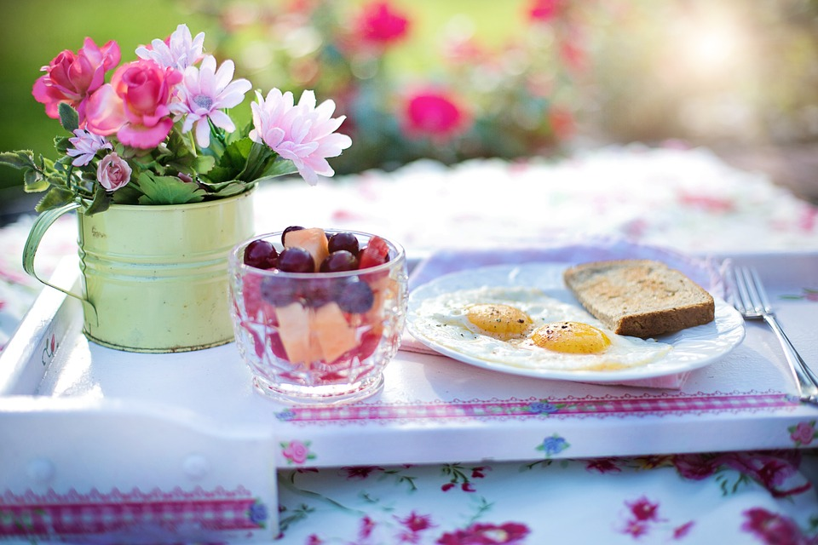
Parts of the speech
Look at the picture and the word given.
What’s the part of speech?
breakfast
noun

Slide 3
Parts of the speech
Look at the picture and the word given.
What’s the part of speech?
play
noun / verb

Slide 4
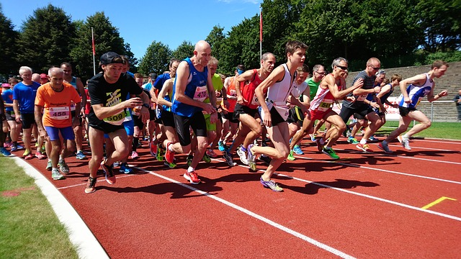
Parts of the speech
Look at the picture and the word given.
What’s the part of speech?
run
noun / verb

Slide 5
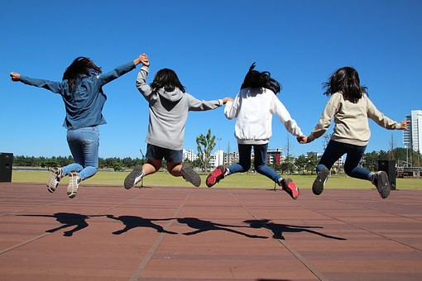
Parts of the speech
Look at the picture and the word given.
What’s the part of speech?
jump
noun / verb

Slide 6
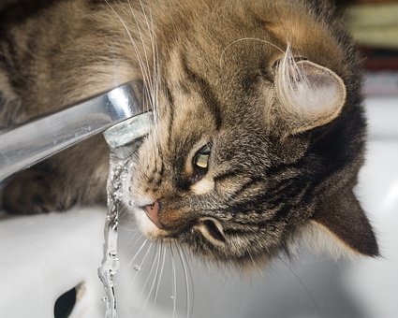
Parts of the speech
Look at the picture and the word given.
What’s the part of speech?
thirsty
adjective

Slide 7
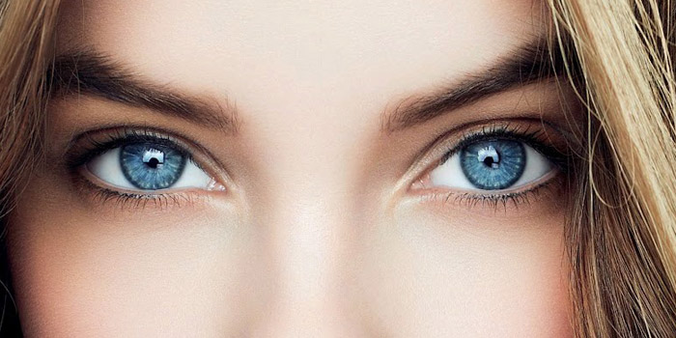
Parts of the speech
Look at the picture and the word given.
What’s the part of speech?
blue
noun/verb/adjective

Slide 8
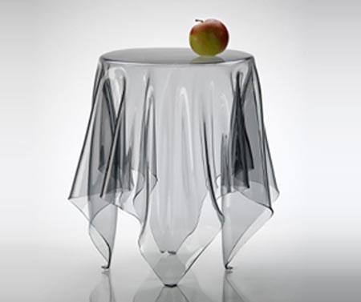
Parts of the speech
Look at the picture and the word given.
What’s the part of speech?
on (the table)
preposition

Slide 9
Parts of the speech
Look at the picture and the word given.
What’s the part of speech?
water
noun / verb

Slide 10
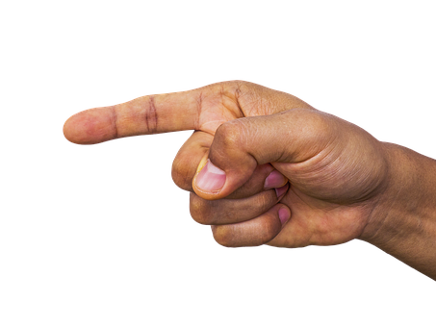
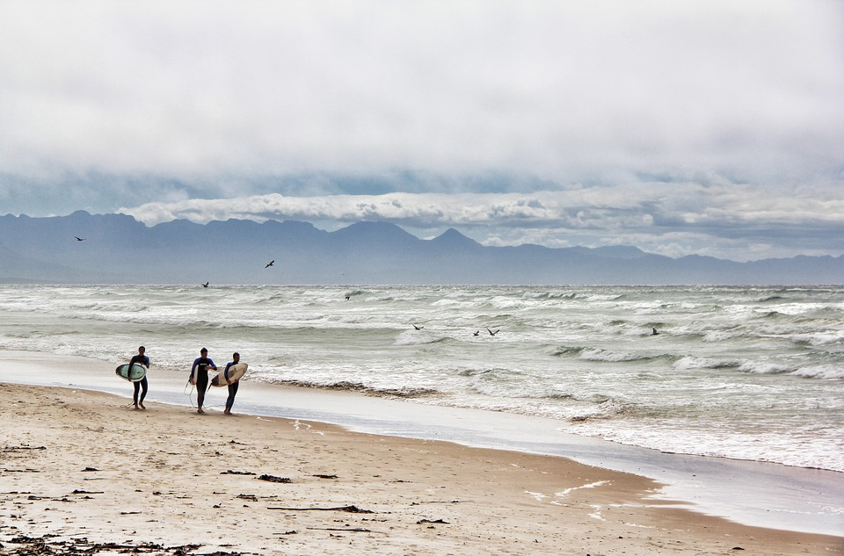
Parts of the speech
Look at the picture and the word given.
What’s the part of speech?
they
pronoun

Slide 11
Parts of the speech
Look at the picture and the word given.
What’s the part of speech?
a (star)
article

Slide 12
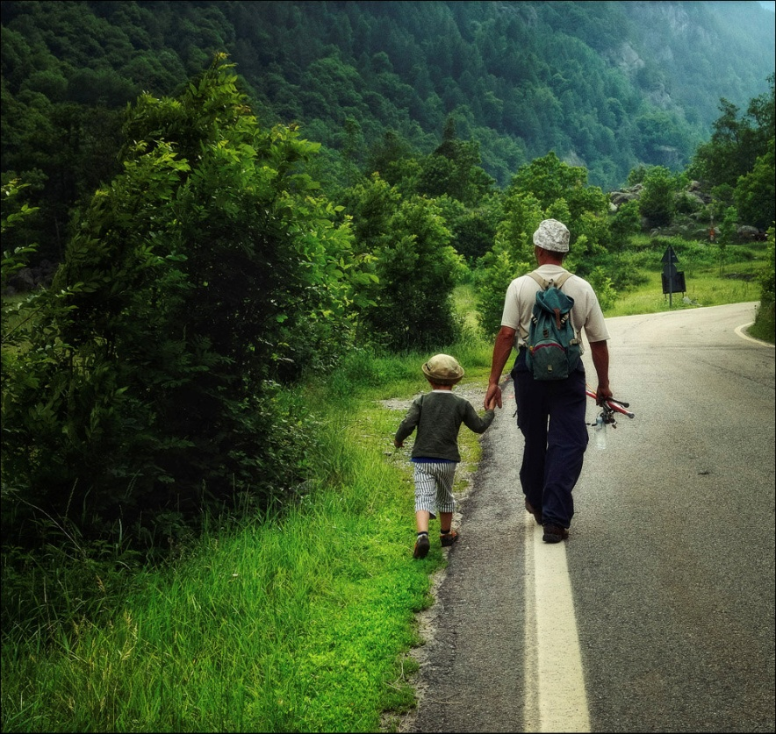
Parts of the speech
Look at the picture and the word given.
What’s the part of speech?
(go) to
preposition

Slide 13
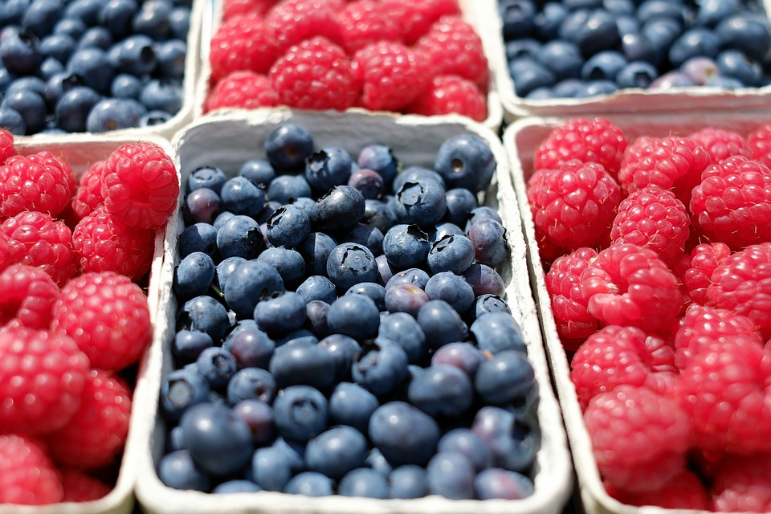
Parts of the speech
Look at the picture and the word given.
What’s the part of speech?
(blueberries) and (raspberries)
conjunction

Slide 14
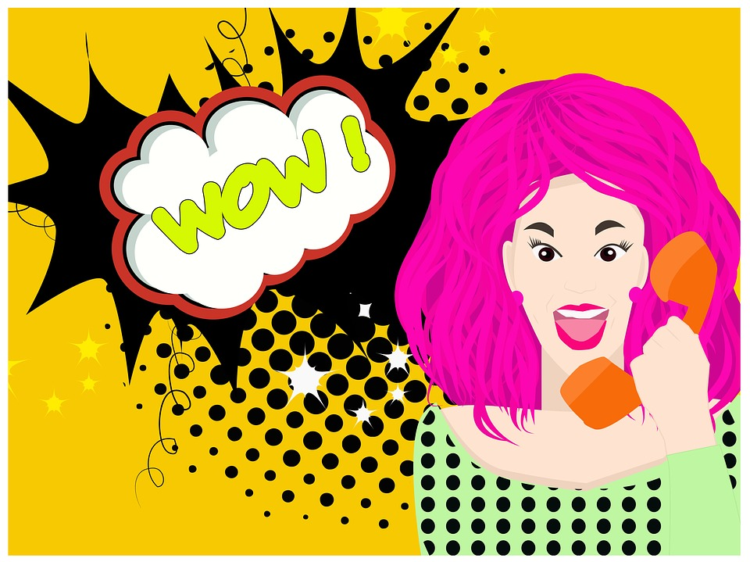
Parts of the speech
Look at the picture and the word given.
What’s the part of speech?
wow
interjection

Slide 15
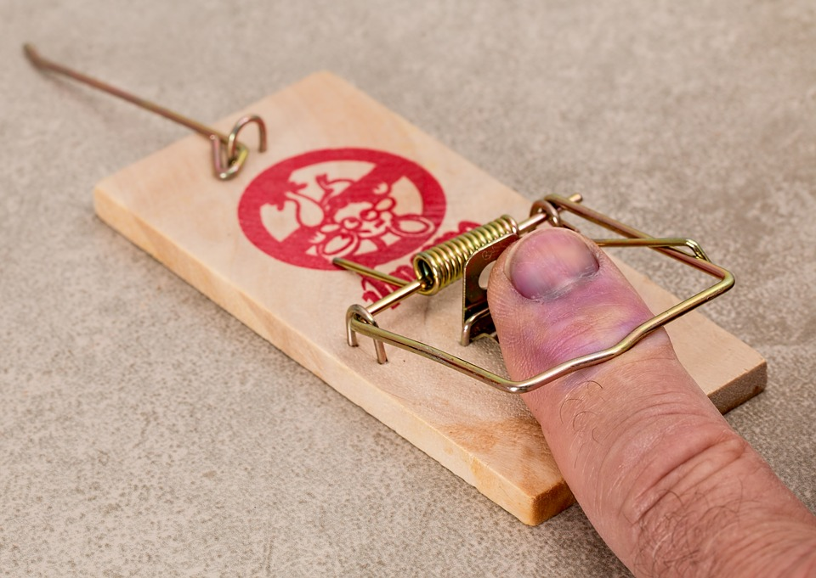
Parts of the speech
Look at the picture and the word given.
What’s the part of speech?
ouch
interjection

Slide 16
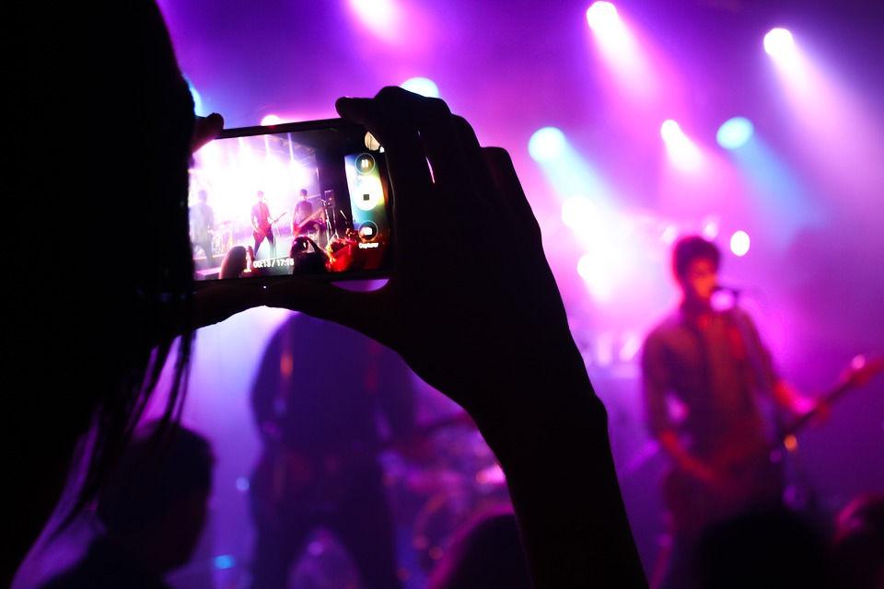
Parts of the speech
Look at the picture and the word given.
What’s the part of speech?
yesterday
noun / adverb

Slide 17
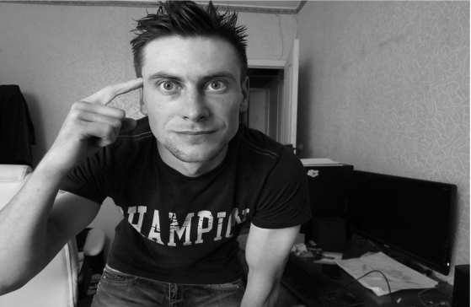
Parts of the speech
Look at the picture and the word given.
What’s the part of speech?
think
noun / verb

Slide 18
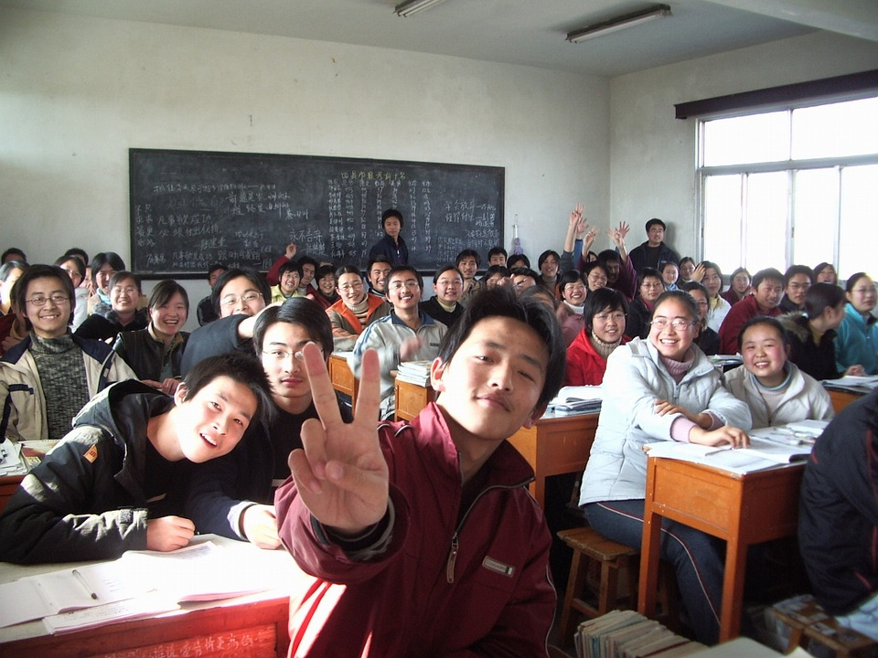
Parts of the speech
Look at the picture and the word given.
What’s the part of speech?
class
noun

Slide 19
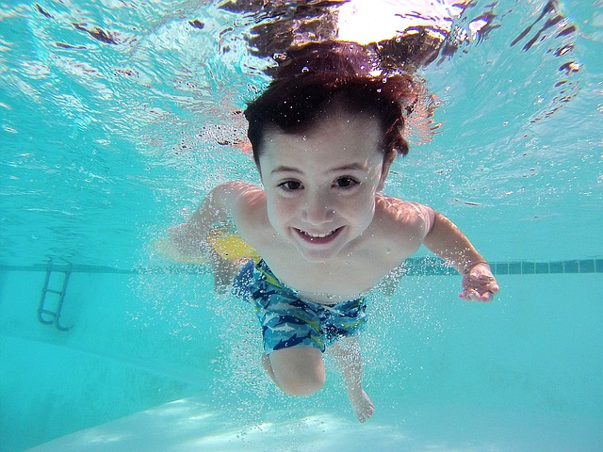
Parts of the speech
Look at the picture and the word given.
What’s the part of speech?
swim
noun / verb

Slide 20
Parts of the speech
Look at the picture and the word given.
What’s the part of speech?
kiss
noun / verb

Slide 21
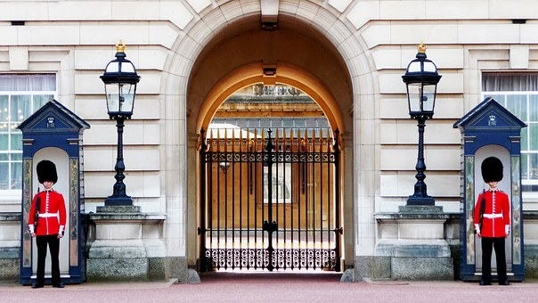
Parts of the speech
Look at the picture and the word given.
What’s the part of speech?
London
noun

Slide 22
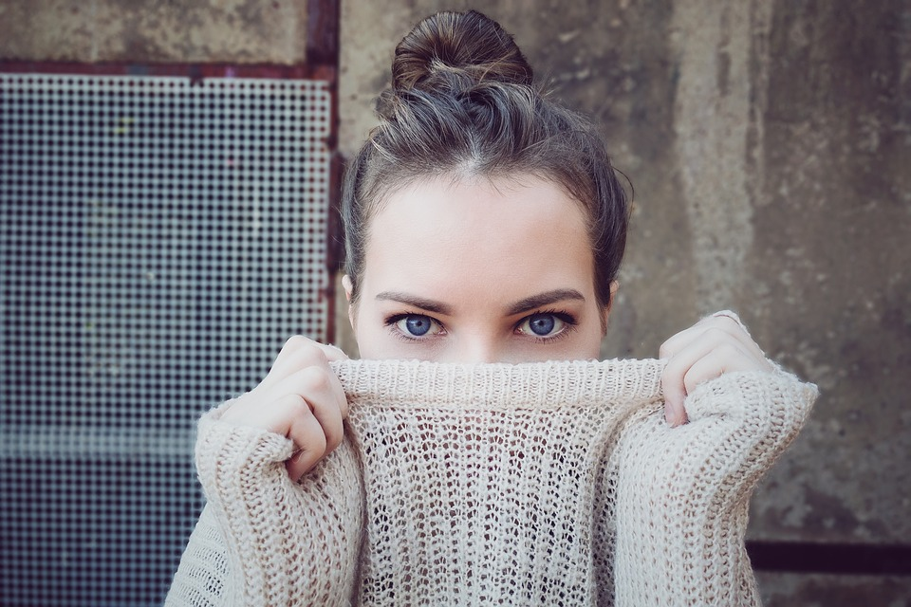
Parts of the speech
Look at the picture and the word given.
What’s the part of speech?
your (eyes are beautiful)
pronoun

Slide 23
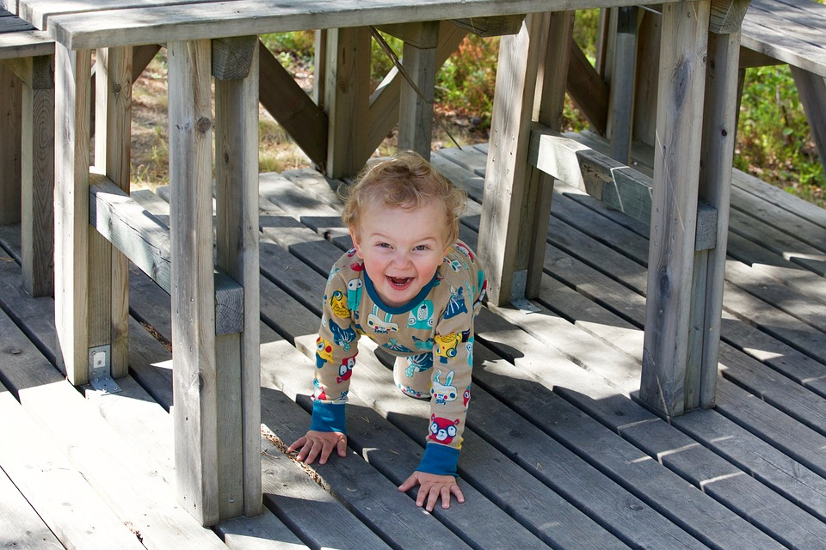
Parts of the speech
Look at the picture and the word given.
What’s the part of speech?
under
preposition

Slide 24
Parts of the speech
Look at the picture and the word given.
What’s the part of speech?
(The book is) yours
pronoun

Slide 25
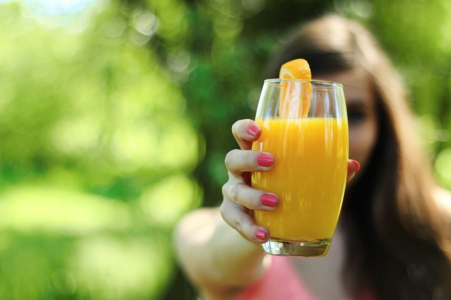
Parts of the speech
Look at the picture and the word given.
What’s the part of speech?
juice
noun / verb

Slide 26
Parts of the speech
Look at the picture and the word given.
What’s the part of speech?
dance
noun / verb

